Slide 1
Microcontroller Subsystem
David King

Slide 2
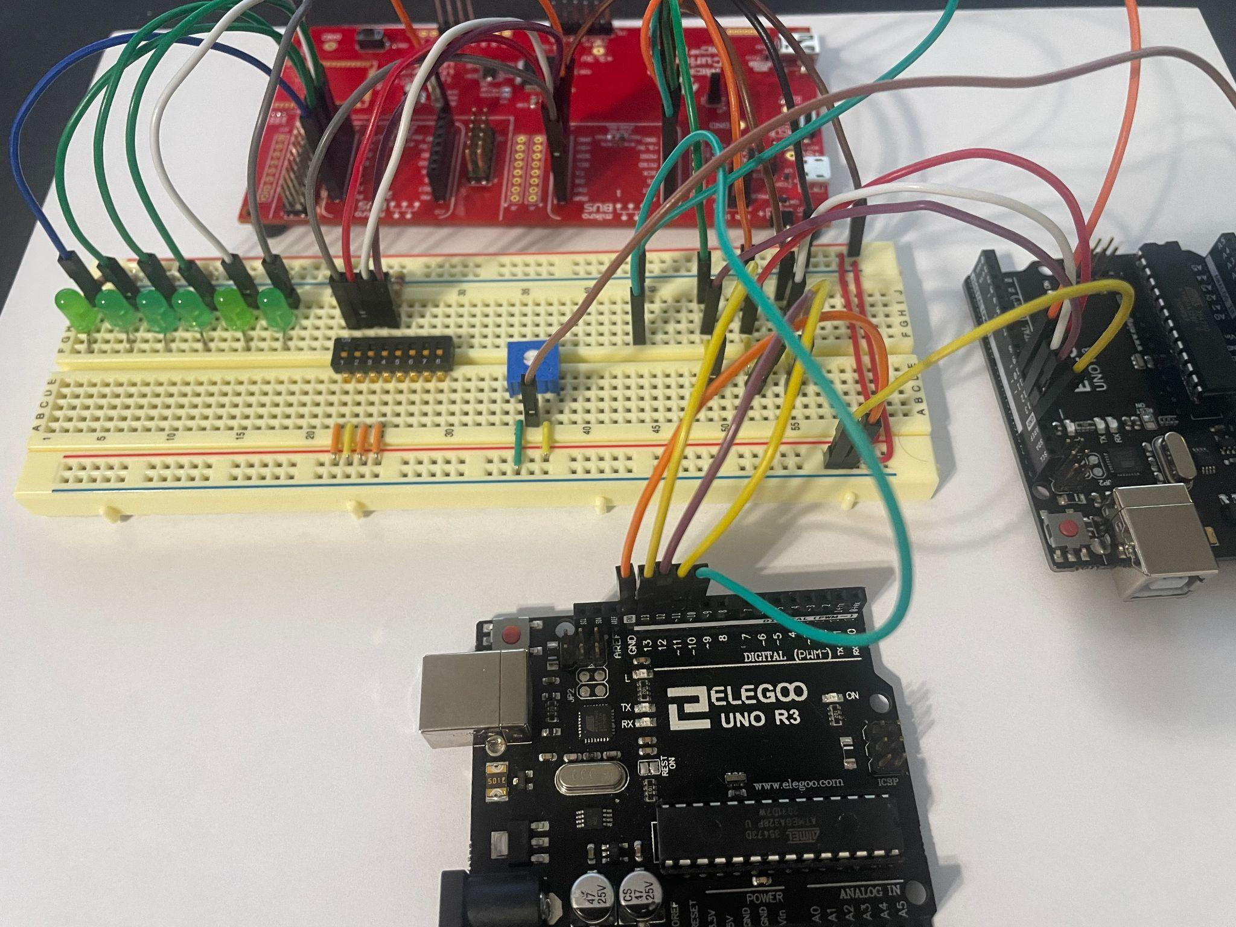
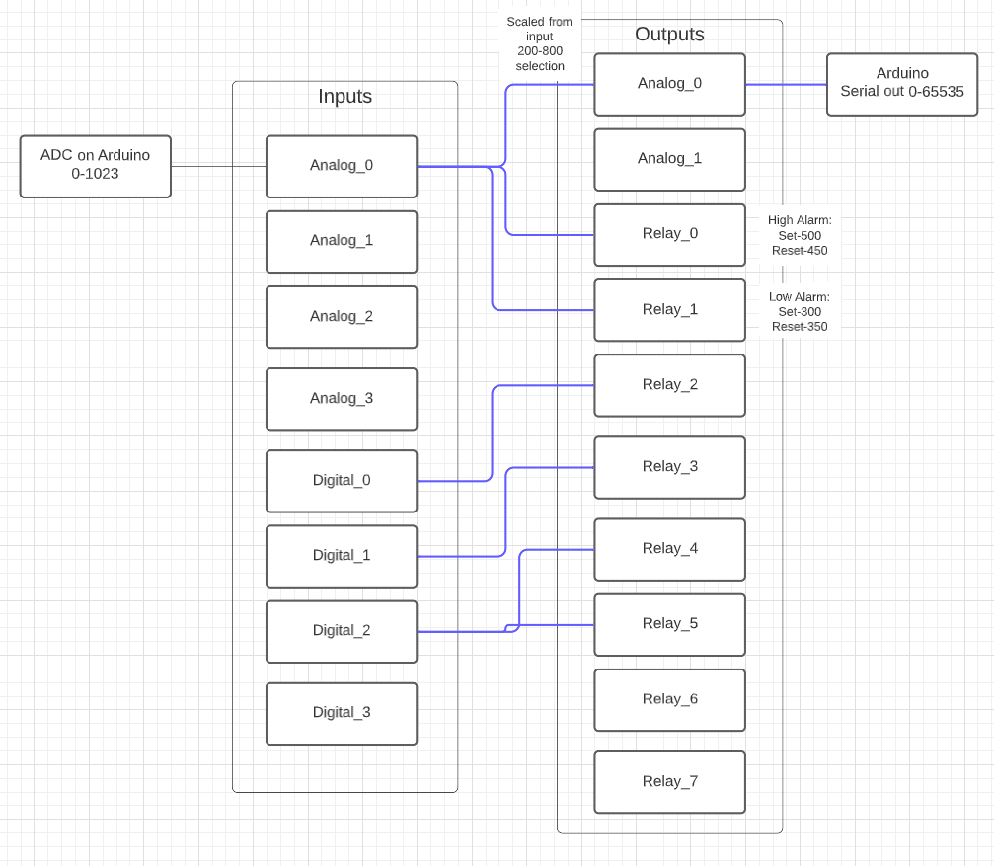
Demo Setup

Slide 3
Demo Setup
The Arduino reads from the potentiometer and sends the reading via SPI to the microcontroller
The raw value as well as the scaled valued is stored
The scaled value is checked against set alarms
If the alarms are to be triggered the corresponding pins are set
The value is scaled to fit user definitions and 16bit output and send to the Arduino simulating the DAC
The Arduino outputs 16bit data it receives as a number via the serial output

Slide 4
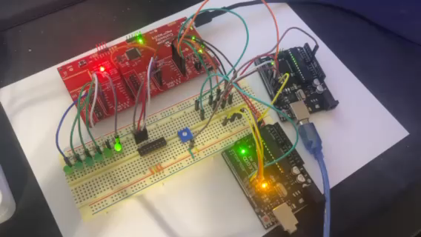
Demo Video

Slide 5
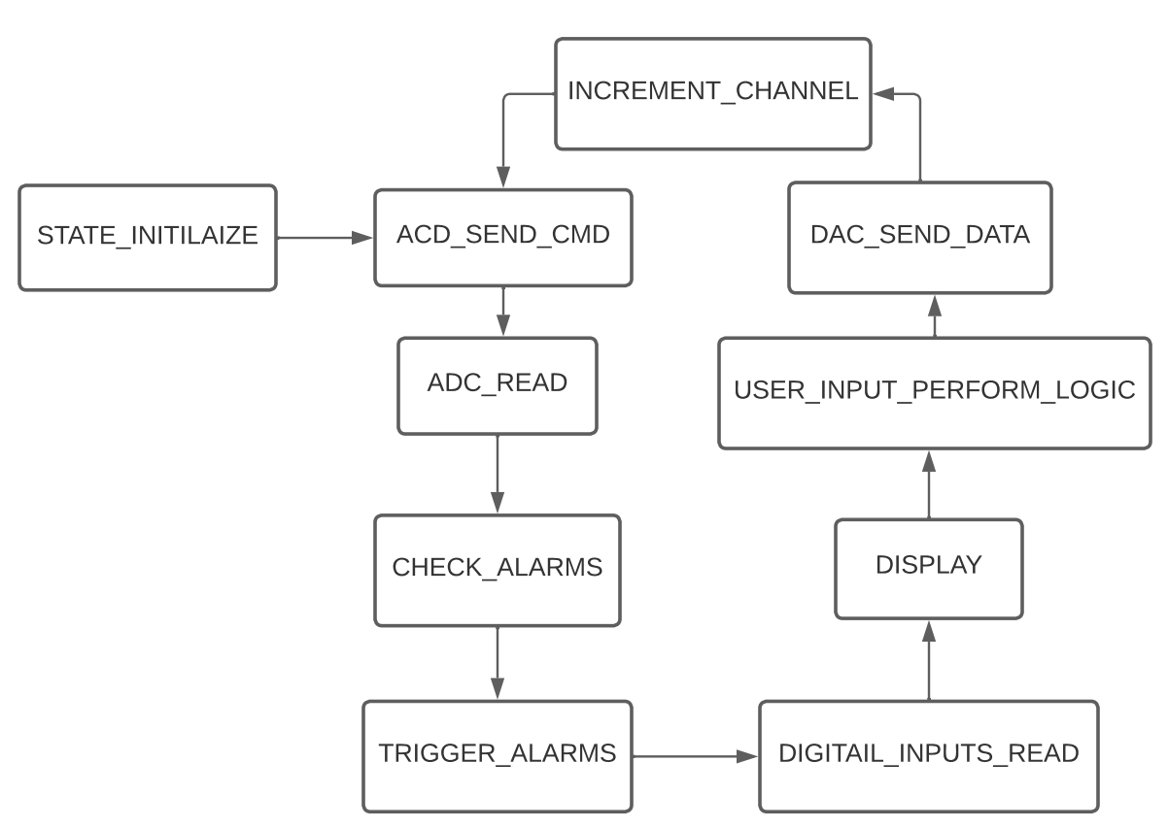
Overall Design
Swap to new task in order shown every 1ms
Timer creates interrupt every 1ms that is used to set flag

Slide 6
Validation 3.2.1.4 Software Alarms
Success Criteria:
System can configure output relays to trigger based on user defined ranges in inputs
Testing Methodology:
Created temporary code to implement various alarms
Digital input simulated using switches to control LEDs simulating relays
Analog input simulated using Arduino ADC and potentiometer
Status: Completed
Success controlling single relay with single digital input
Success controlling multiple relays with single digital input
Success controlling relay via High/Low Alarm configured analog input
Success controlling relay via Low/High Alarm configured from analog input

Slide 7
Validation 3.2.1.3 Software Output Control
Success Criteria:
System is able to control the 2 analog outputs and 8 relay outputs
Testing Methodology:
Created temporary code to configure outputs
Analog input simulated using Arduino ADC and potentiometer
Analog output simulated using Arduino to display via Serial interface
Status: Completed
Success transmitting data to simulated DAC output
Success controlling simulated relays (LEDs)

Slide 8
Validation 3.2.1.2 Software Input Control
Success Criteria:
System is able to control following input: 4 analog inputs, 4 digital inputs
Testing Methodology:
Created temporary code to configure inputs
Analog input simulated using Arduino ADC and potentiometer
Digital inputs simulated using switches
Status: Completed
Success transmitting ADC commands to configure ADC
Success receiving simulated data from Arduino
Success reading input from simulated digital inputs

Slide 9
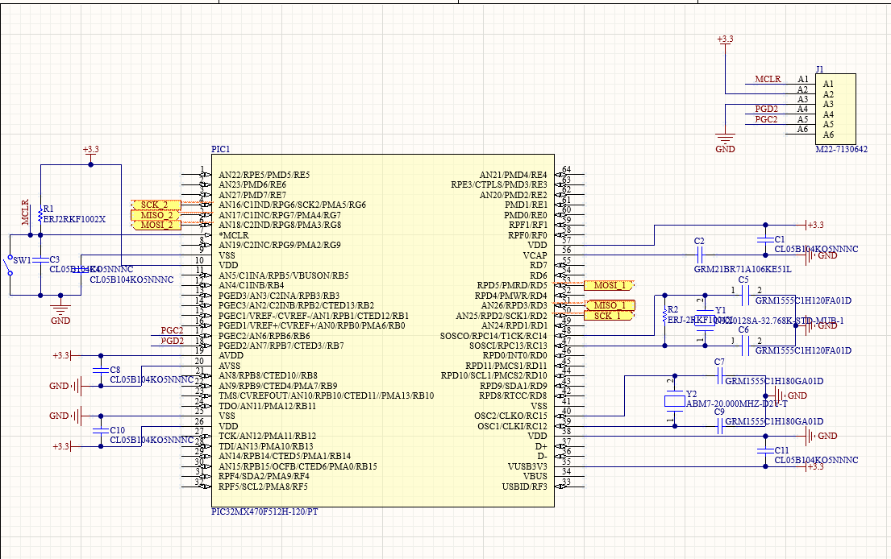
Altium Schematic

Slide 10
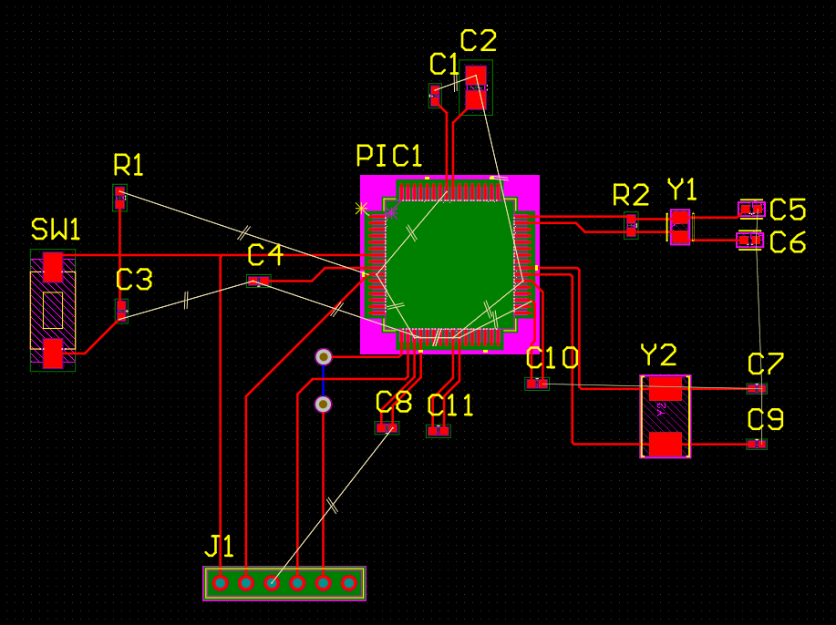
Altium PCB

Slide 11
Input-Output
Each input can have at most 4 alarms
Each output can only be configured to one input
The 2 Analog outputs can be set to use a scaled portion of the input data
The user can set a range for the max/min that is equivalent t to the 4-20mA
The user can select a range from within the input range to output to the Analog Output
0xFFFFFF
100
0xFFFF
60
80
20
0
0
0
0

Slide 12
STATE_INITIALIZE
ADC_SEND_CMD
All the inputs and outputs are initialized to default values
The ADC is configured to run in Continuous mode
The ADC is send a command to select the current input channel is the channel has been configured

Slide 13
ADC_READ
DIGITAL_INPUTS_READ
Send command to ADC to goto the data register
Read the output of the data register from the ADC and store the
Save the data if thirty seconds have passed
Convert the raw data to the scale set by user and save
Read and save the state of the Digital inputs.

Slide 14
DISPLAY
USER_INPUT_PERFORM_LOGIC
Reserved for future use
Reserved for future use

Slide 15
CHECK_ALARMS
TRIGGER_ALARMS
Cycle through alarms on current input channel
Check if analog
alarm is high/low
Set alarm if value is higher than trigger
Clear alarm if value is lower than reset
Alarm is low/high
Set alarm if value if lower than trigger
Clear alarm if value is higher than reset
Check if digital
Set alarm if digital on, clear if off
Set the alarms that were set to be true from previous task

Slide 16
DAC_SEND_DATA
INCREMENT_CHANNEL
Take the scaled data from the input and scaled to the output scale set by user, then scale to 16bit (0-65535)
Send 16bit data to current DAC channel
Set the alarms that were set to be true from previous task

